Slide 1

Secure Multi-Client File Sharing System using C Sockets
This project presents a robust and secure file sharing system leveraging C sockets, suitable for multiple clients simultaneously. Built with core technologies including POSIX threads for concurrency, TCP sockets for reliable communication, and SQLite for metadata persistence, it offers a practical example of combining low-level networking with database integration.
Our team engineered a centralized server model that handles client requests securely and efficiently, providing both public and private file access modes. This presentation details the architecture, features, command interface, and code highlights, demonstrating our comprehensive approach to networked file sharing in C.

Slide 2

Project Objectives
Simple & Secure File Sharing
Public and Private Sharing
Enable multiple clients to upload and download files from a central server with secure protocols ensuring data integrity and privacy.
Offer flexible access control through public visibility, private sharing with access code protection, and user-only files.
Real-Time Transfer Feedback
Display download and upload progress bars with speed metrics for an intuitive user experience during transfers.

Slide 3
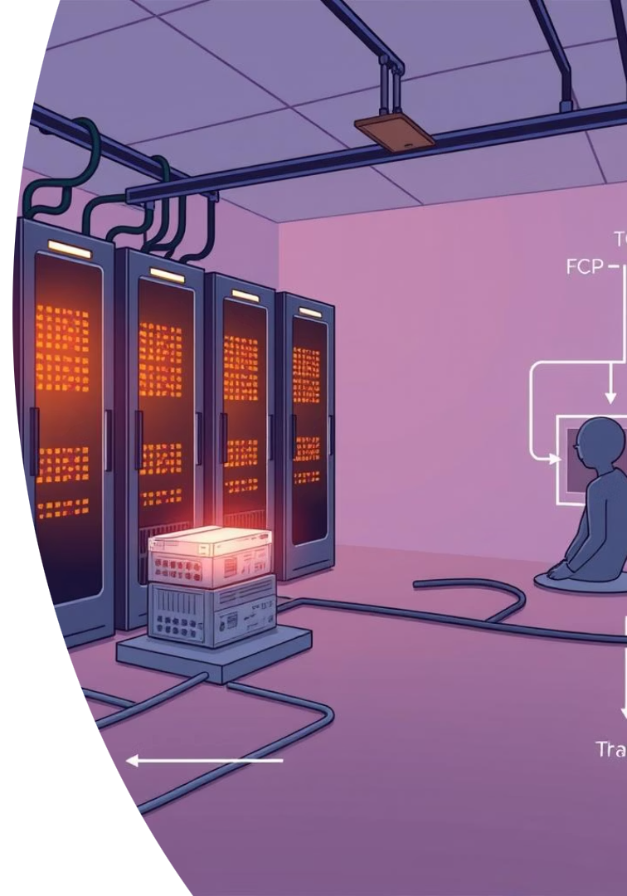
System Architecture
Client-Server Communication
POSIX Threads for Concurrency
SQLite Metadata Storage
Clients communicate with the server over TCP on port 8080, ensuring reliable data transfer and connection stability.
Each incoming client connection spawns a dedicated thread, allowing simultaneous handling of multiple uploads/downloads.
User credentials, file metadata, and access control details are maintained persistently using SQLite, enabling robust authentication and authorization.
The server listens and manages multiple client connections concurrently.
This design maximizes responsiveness and throughput in a multi-user environment.

Slide 4
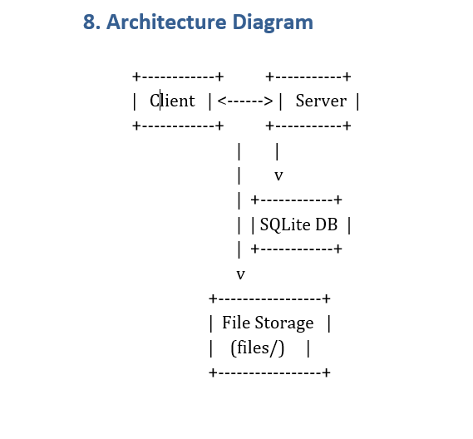
System Architecture

Slide 5
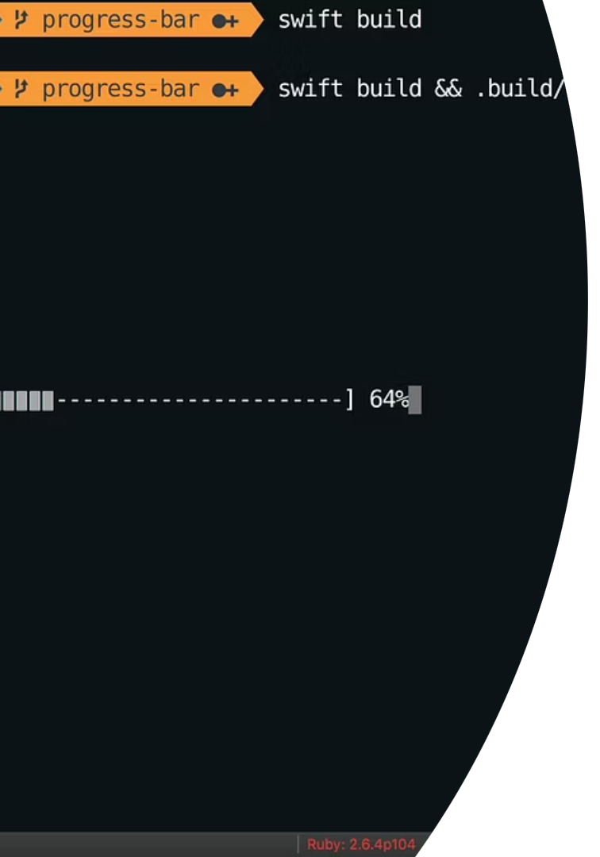
Key Features Overview
User Registration & Login
Secure credential storage and verification facilitate user authentication to safeguard file access.
Flexible File Visibility
Files can be shared publicly, restricted with an access code, or limited to the uploader’s account.
Multithreaded Client Support
Concurrent client connections are handled with pthreads, enabling efficient parallel file transfers.
Transfer Progress Feedback
Users see a real-time terminal progress bar indicating transfer percentage and speeds for better usability.

Slide 6
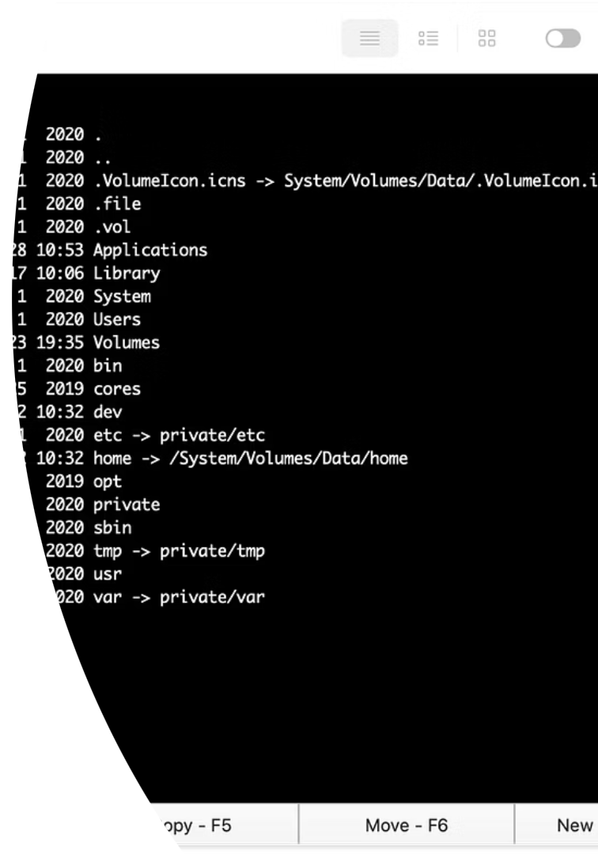




Supported Client Commands
/upload
/download
/list
Send files to the server, specifying visibility options.
Retrieve files from the server, including entering access codes for private files.
Display available files on the server with visibility and ownership details.
/locallist
Show files present locally on the client device.
Additional commands /help and /exit provide user assistance and session termination respectively.

Slide 7
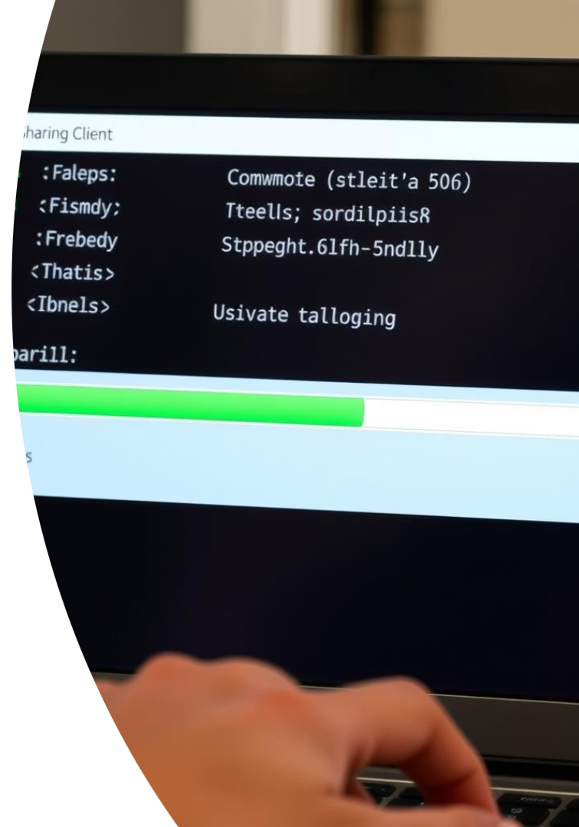




Live Demonstration Workflow
Register or Login
Users begin by creating a new account or logging into an existing one for secure access.
Upload Files
Files are uploaded with selected visibility settings, supporting public or restricted sharing.
View File List
Clients retrieve and list files currently stored on the server, filtering by access rights.
Download and Progress
Files are downloaded with optional access code verification, accompanied by a terminal progress bar showing speed and ETA.

Slide 8

Client Code Highlights
Threaded Communication
File I/O Management
Filename Conflict Resolution
Access Code Handling
Efficient buffered file reads and writes with a real-time progress meter updating terminal display.
On accessing private files, clients prompt for access codes and send them securely to the server for validation.
Separate send and receive threads ensure asynchronous network operations and responsive UI.
Automatic renaming ensures that downloaded files do not overwrite existing local data.

Slide 9
Server Code Highlights
Concurrent Client Handling
Secure Credential Verification
Uses multithreaded architecture to support multiple clients simultaneously with pthreads.
Validates user credentials securely to ensure authorized file access.
Access Control Management
Robust File I/O
Enforces file visibility settings and manages access codes for private files.
Handles file storage efficiently with buffered reads/writes and error handling.

Slide 10
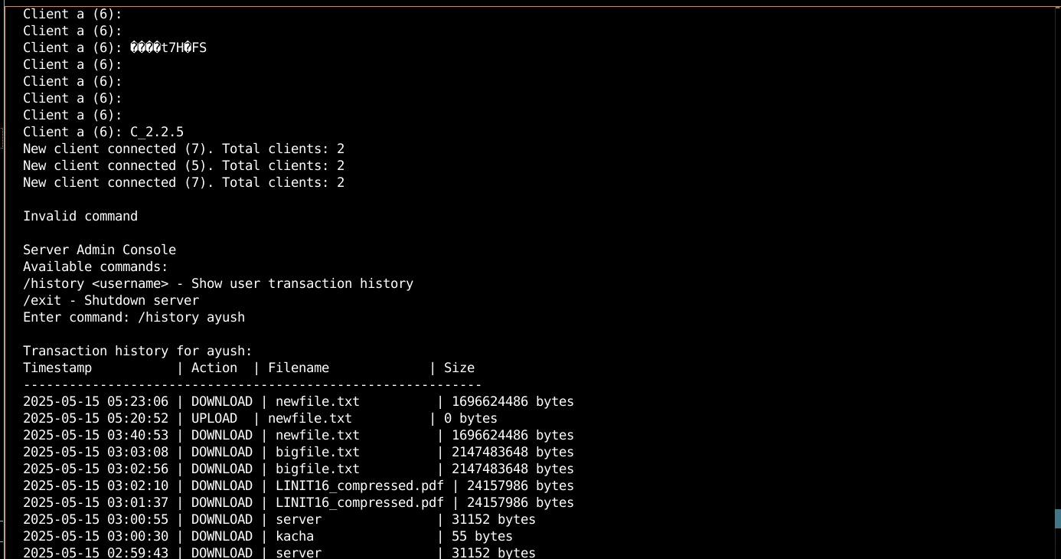
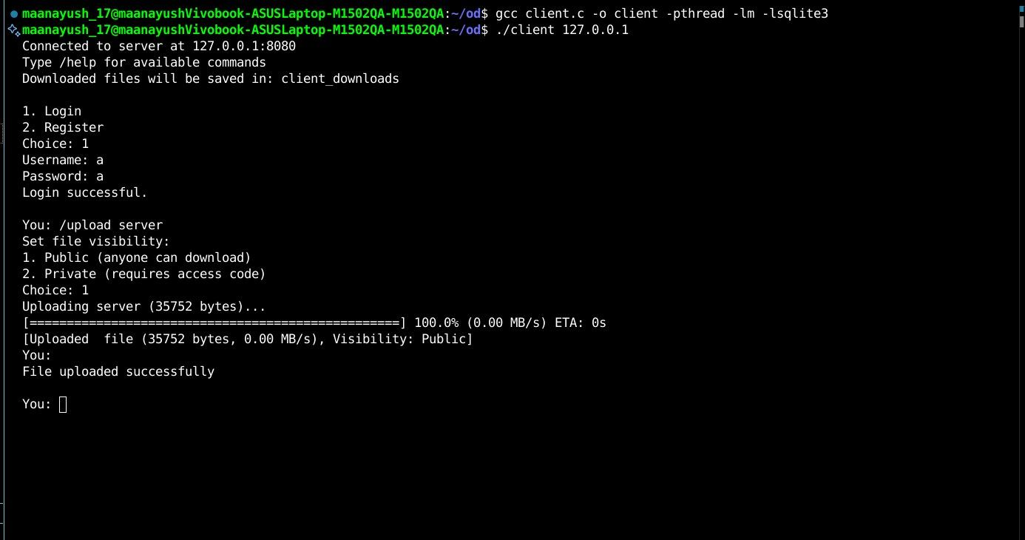
Sample Output and User Feedback
Registration Confirmation
Download Status and List Output
Users receive clear success or error messages upon registering or logging in.
File lists clearly display file names and access requirements; download results show success or failure states.
Progress Bar Detail
Terminal progress bars depict percentage complete, transfer speed, and estimated time remaining for a smooth user experience.

Slide 11
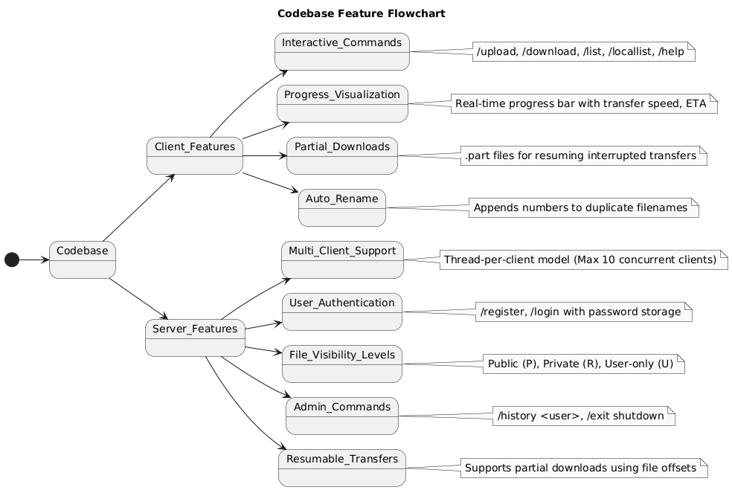
Modular Design: Features

Slide 12
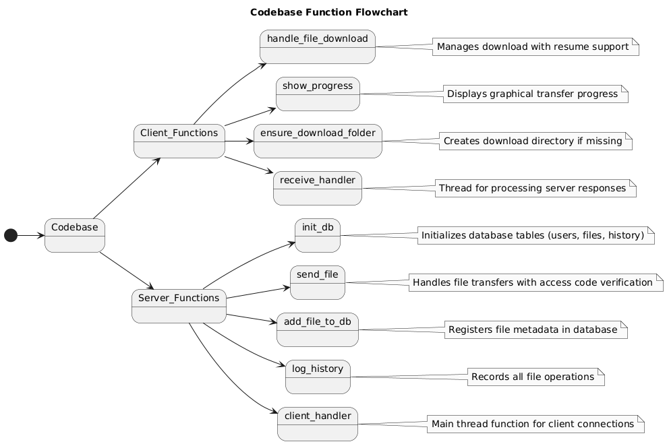
Modular Design: Functions

Slide 13

Conclusion and Key Takeaways
This project delivers a fully functional, multi-client file sharing system built in C, demonstrating the practical integration of sockets, threading, and database technology.
It supports concurrent user sessions with enforced access control, real-time progress indicators, and flexible visibility options, providing a secure and scalable platform for file exchange. This approach can be extended further to include encryption, GUI clients, and advanced authentication for production environments.

Slide 14
Thank You

